Slide 1

UNIVERSITY INSTITUTE OF ENGINEERING
COMPUTER SCIENCE ENGINEERING
ARTIFICIAL INTELLIGENCE
(23CSH-621)
INTRODUCTION
DISCOVER . LEARN . EMPOWER

Slide 2
Knowledge Representation
When we use search to solve a problem we must
Capture the knowledge needed to formalize the problem
Apply a search technique to solve problem
Execute the problem solution

Slide 3
Role of KR
The first step is the role of “knowledge representation” in AI.
Formally,
The intended role of knowledge representation in artificial intelligence is to reduce problems of intelligent action to search problems.
A good description, developed within the conventions of a good KR, is an open door to problem solving
A bad description, using a bad representation, is a brick wall preventing problem solving

Slide 4
A Knowledge-Based Agent
We previously talked about applications of search but not about methods of formalizing the problem.
Now we look at extended capabilities to general logical reasoning.
Here is one knowledge representation: logical expressions.
A knowledge-based agent must be able to
Represent states, actions, etc.
Incorporate new percepts
Update internal representations of the world
Deduce hidden properties about the world
Deduce appropriate actions
We will
Describe properties of languages to use for logical reasoning
Describe techniques for deducing new information from current information
Apply search to deduce (or learn) specifically needed information

Slide 5
WW Environment Properties
Observable?
Partial
Deterministic?
Yes
Episodic?
Sequential
Static?
Yes (for now), wumpus and pits do not move
Discrete?
Yes
Single agent?
Multi (wumpus, eventually other agents)

Slide 6
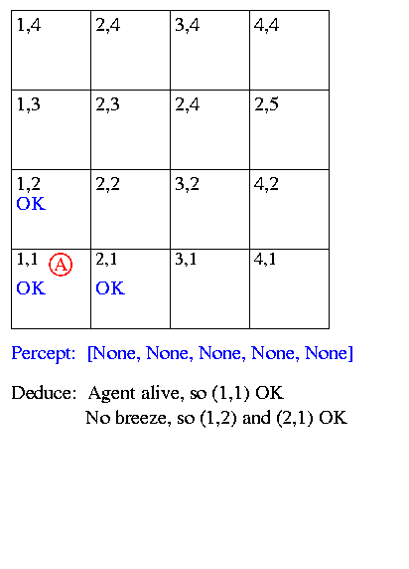
Sample Run

Slide 7
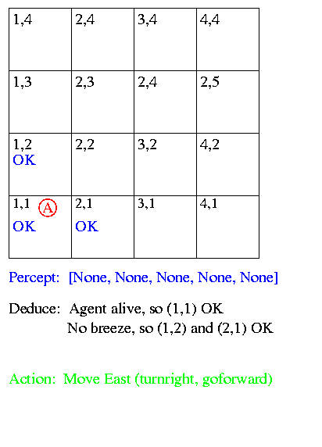
Sample Run

Slide 8
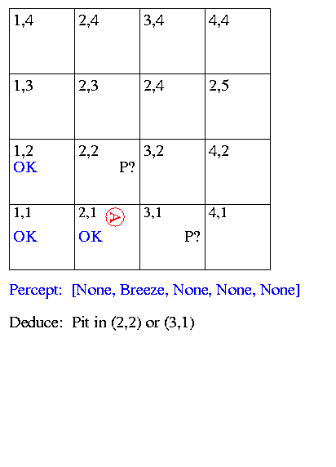
Sample Run

Slide 9
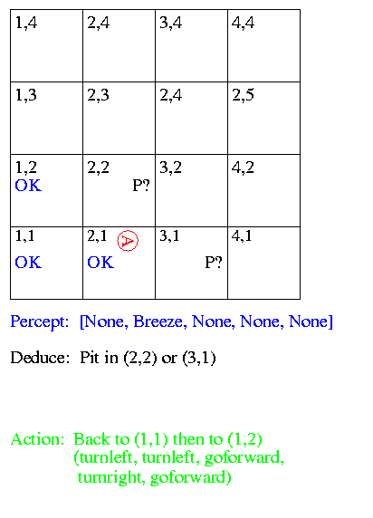
Sample Run

Slide 10
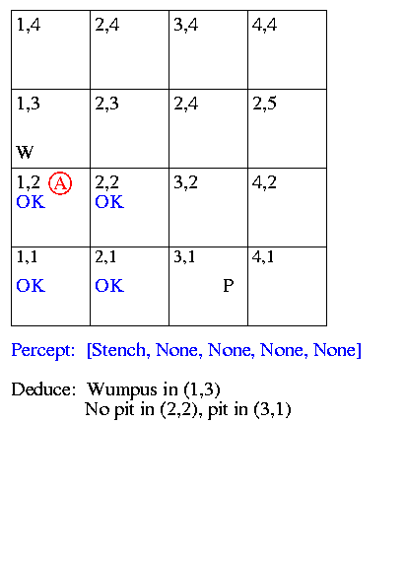
Sample Run

Slide 11
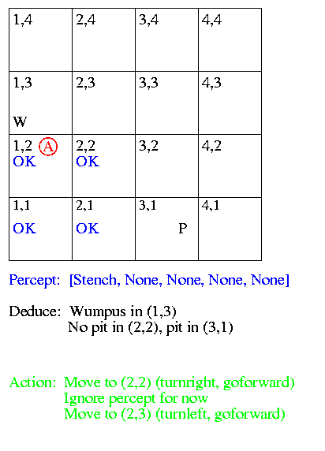
Sample Run

Slide 12
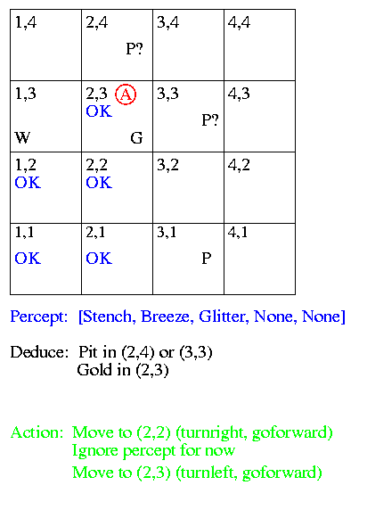
Sample Run

Slide 13
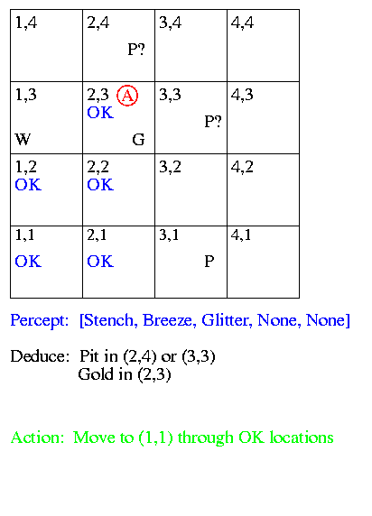
Sample Run

Slide 14
Sample Run
Now we look at
How to represent facts / beliefs
“There is a pit in (2,2) or (3,1)”
How to make inferences
“No breeze in (1,2), so pit in (3,1)”

Slide 15
Representation, Reasoning and Logic
Sentence: Individual piece of knowledge - English sentence forms one piece of knowledge in English language - Statement in C forms one piece of knowledge in C programming language
Syntax: Form used to represent sentences - Syntax of C indicates legal combinations of symbols - a = 2 + 3; is legal
- a = + 2 3 is not legal
- Syntax alone does not indicate meaning
Semantics: Mapping from sentences to facts in the world - They define the truth of a sentence in a “possible world” - Add the values of 2 and 3, store them in the memory location indicated by variable a
In the language of arithmetic:
x + 2 >= y is a sentence x2 + y > is not a sentence x + 2 >= y is true in all worlds where the number x + 2 is
no less than the number y x + 2 >= y is true in a world where
x = 7, y = 1 x + 2 >= y is false in a world where
x = 0, y = 6

Slide 16
Entailment
There can exist a relationship between items in the language
Sentences “entail” sentences (representation level)
Facts “follow” from facts (real world)
Entail / Follow mean the new item is true if the old items are true
A collection of sentences, or knowledge base (KB), entail a sentence
KB |= sentence
KB entails the sentence iff the sentence is true in all worlds where the KB is true
Entails
Sentences
Sentence
Semantics
Semantics
Representation
World
Follows
Facts
Fact

Slide 17
Entailment Examples
KB
The Giants won
The Reds won
Entails
Either the Giants won or the Reds won
KB
To get a perfect score your program must be turned in today
I always get perfect scores
Entails
I turned in my program today
KB
CookLectures -> TodayIsTuesday v TodayIsThursday
- TodayIsThursday
TodayIsSaturday -> SleepLate
Rainy -> GrassIsWet
CookLectures v TodayIsSaturday
- SleepLate
Which of these are correct entailments?
- Sleeplate
GrassIsWet
- SleepLate v GrassIsWet
TodayIsTuesday
True

Slide 18
Inference
Use two different ways:
Generate new sentences that are entailed by KB
Determine whether or not sentence is entailed by KB
A sound inference procedure generates only entailed sentences
Modus ponens is sound
Abduction is not sound
Logic gone bad

Slide 19
Definitions
A complete inference procedure can generate all entailed sentences from the knowledge base.
The meaning of a sentence is a mapping onto the world (a model).
This mapping is an interpretation (interpretation of Lisp code).
A sentence is valid (necessarily true, tautology) iff true under all possible interpretations.
A V -A
A could be:
Stench at [1,1]
Today is Monday
2+3=5
These statements are not valid.
A ^ -A
A V B
The last statement is satisfiable, meaning there exists at least one interpretation that makes the statement true. The previous statement is unsatisfiable.

Slide 20
Logics
Logics are formal languages for representing information such that conclusions can be drawn
Logics are characterized by their “primitives” commitments
Ontological commitment: What exists? Facts? Objects? Time? Beliefs?
Epistemological commitment: What are the states of knowledge?
Language | Ontological Commitment | Epistemological Commitment
Propositional logic | facts | true/false/unknown
First-order logic | facts, objects, relations | true/false/unknown
Temporal logic | facts, objects, relations, times | true/false/unknown
Probability theory | facts | value in [0, 1]
Fuzzy logic | degree of truth | known interval value

Slide 21
Examples
Propositional logic
Simple logic
Symbols represent entire facts
Boolean connectives (&, v, ->, <=>, ~)
Propositions (symbols, facts) are either TRUE or FALSE
First-order logic
Extend propositional logic to include variables, quantifiers, functions, objects

Slide 22
Propositional Logic
Proposition symbols P, Q, etc., are sentences
The true/false value of propositions and combinations of propositions can be calculated using a truth table
If P and S are sentences, then so are –P, P^Q, PvQ, P->Q, P<->Q
An interpretation I consists of an assignment of truth values to all proposition symbols I(S)
An interpretation is a logician's word for what is often called a “possible world”
Given 3 proposition symbols P, Q, and R, there are 8 interpretations
Given n proposition symbols, there are 2^{n} interpretations
To determine the truth of a complex statement for I, we can
Substitute I's truth value for every symbol
Use truth tables to reduce the statement to a single truth value
End result is a single truth value, either True or False

Slide 23
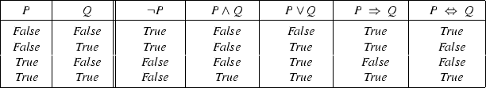
Propositional Logic
For propositional logic, a row in the truth table is one interpretation
A logic is monotonic as long as entailed sentences are preserved as more knowledge is added

Slide 24
Rules of Inference for Propositional Logic
Modus ponens
And introduction
Or introduction
And elimination
Double-negation elimination
Unit resolution
Resolution
All men are mortal (Man -> Mortal)
Socrates is a man (Man)
-----------------------------------------------
Socrates is mortal (Mortal)
Today is Tuesday or Thursday
Today is not Thursday
---------------------------------------
Today is Tuesday
Today is Tuesday or Thursday
Today is not Thursday or tomorrow is Friday
----------------------------------------------------------
Today is Tuesday or tomorrow is Friday

Slide 25
THANK YOU

